Slide 1


APP USER MANUAL – ROT FREE FARM!
By: Lakshanya Jayakumar

Slide 2
Table of contents
01
02
03
04
Vote of Thanks
My Introduction
Internship Journey
05
06
About
App
How to use my app
Contact Me

Slide 3
VOTE OF THANKS!💖
A small vote of thanks to all who have helped me in this journey of App Development –my parents, Mentors, Dr. Ken Kahn, Group Members, Friends, etc. I would like to give a big thank you to Miss Sanjana for making this journey amazing! Thank you Clevered team for this opportunity!
💝

Slide 4
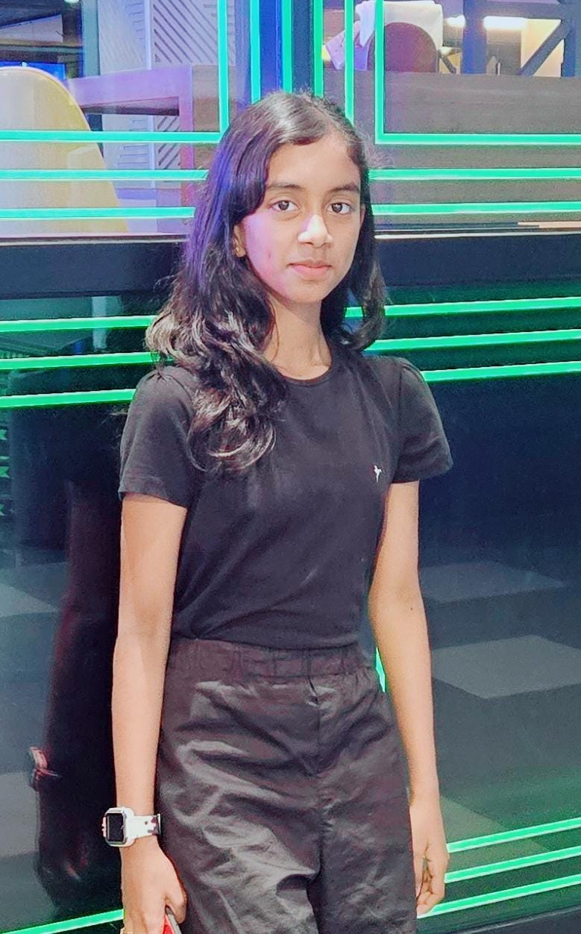
My Introduction
My name is Lakshanya Jayakumar.
I am 11 years old.
I live in UAE, Dubai.
I am studying at Al Diyafah High School, Grade 6.
My Hobbies are Coding, Singing, and Reading.
👩‍💻 🎤 📖
When I grow up I want to be a Software Engineer.

Slide 5
MY APP:-
The App that I have chosen is the Rotten Fruit Detection App… Name of my App:- ROT FREE FARM!
Rot Free Farm is a rotten fruit detection app where farmers can find out whether the fruit is rotten or not… This app can also be used by customers at local supermarkets…
This app is very helpful in the community!

Slide 6
HOW TO USE THE APP??
🖥️
👩‍💻

Slide 7
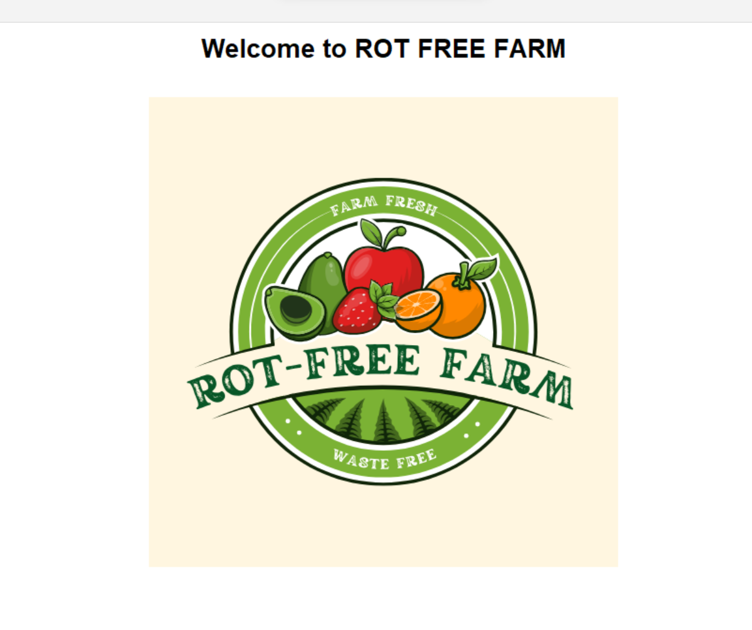
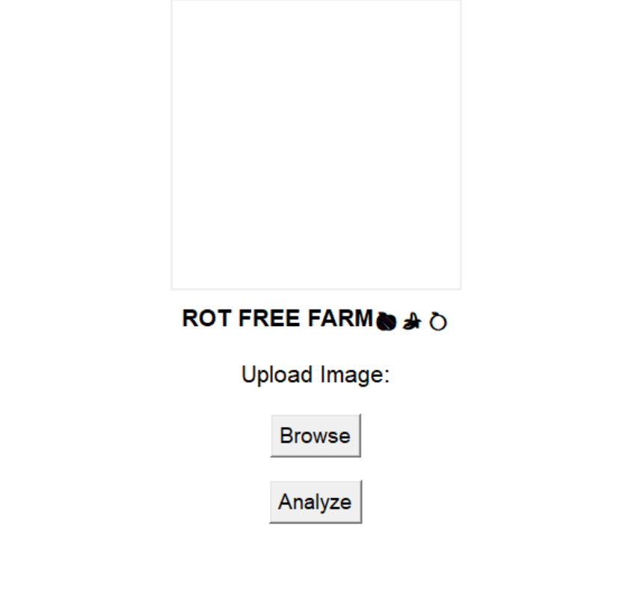
This button will open files and let you choose which image you would like to put
CLICK ON THE IMAGE TO GO TO THE NEXT SCREEN
Analyzes whether the fruit is fresh or stale

Slide 8
Toolkit Walkthrough
🖥️
👩‍💻

Slide 9
Contact Person:
If any queries or doubts reach out to Lakshanya J at lakshu.jk2012@gmail.com for any questions or concerns/ suggestions on the App!

Slide 10
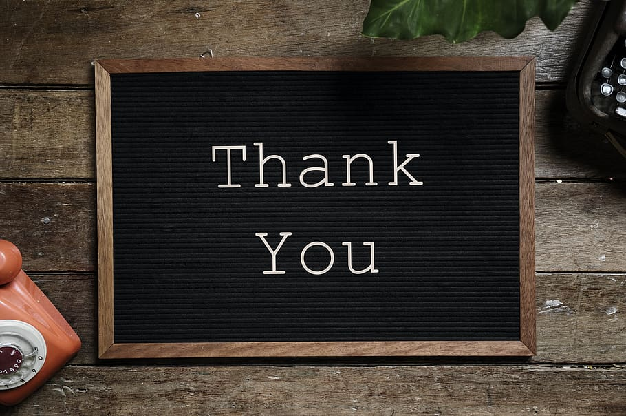

My Experience For this level in Clevered
This level was a great Level for me… I learned a lot of new and interesting concepts in Python, and I hope for more fun like this in Clevered… Thank you, Miss Pratibha, for this amazing Journey…💖

